Slide 1
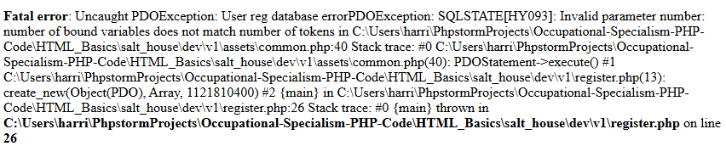
1.
Error was thrown due to syntax error see fixed syntax above

Slide 2
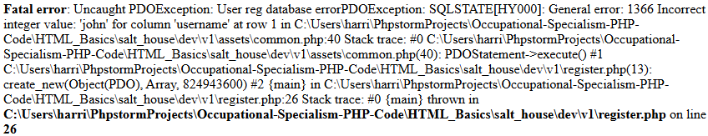
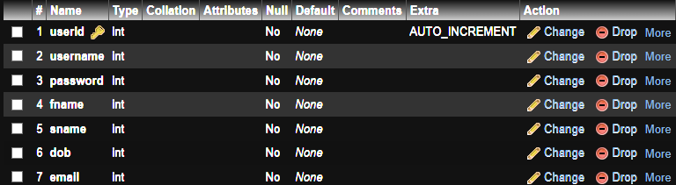
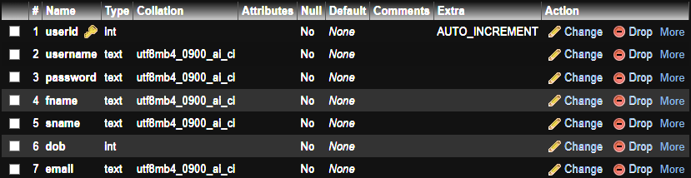
2.
Error has been thrown due to database field types being wrong see fixes above

Slide 3
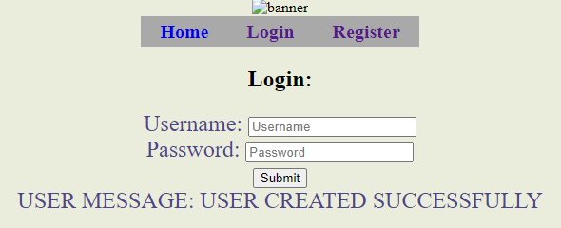
3.

Slide 4
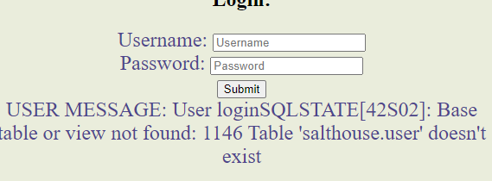
4.
Table name has been misspelt so error has been thrown see fixes above

Slide 5

5.

Slide 6
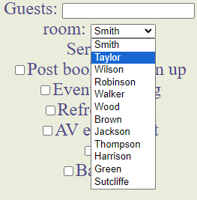
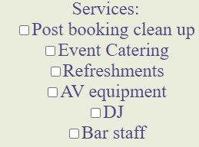
6.

Slide 7


5.

Slide 8
5.

Slide 9
5.

Slide 10
5.

Slide 11
5.

Slide 12
5.

Slide 13
5.

Slide 14
5.

Slide 15
5.

Slide 16
5.

Slide 17
5.

Slide 18
5.

Slide 19
5.

Slide 20
5.

Slide 21
5.

Slide 22
5.

Slide 23
5.

Slide 24
5.

Slide 25
5.

Slide 26
5.

